Slide 1
MongoDB and CRUD Operations

Slide 2
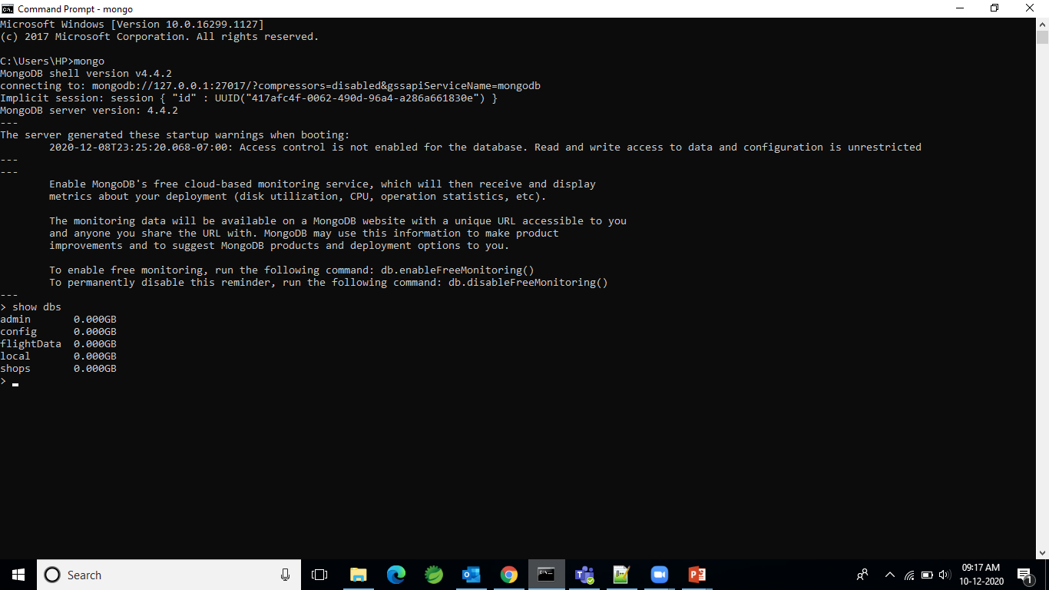
Open Command prompt mongo Show Databases --- show dbs

Slide 3

Create a database or switch to the database.

Slide 4
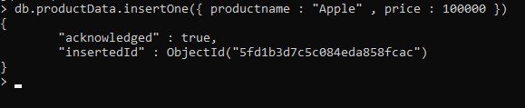
Insert the data into database.

Slide 5
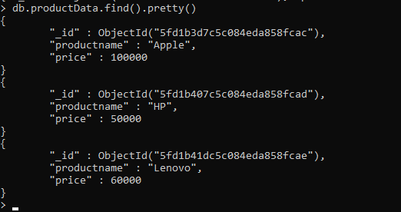
Read the data

Slide 6

Read the data with condition

Slide 7

Update one with condition

Slide 8

Update many

Slide 9
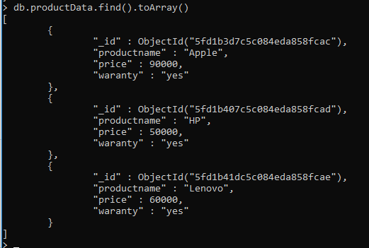
Display with toArray()

Slide 10
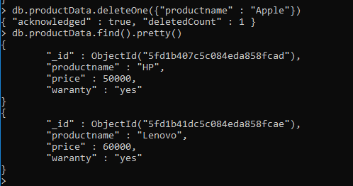
Deleting one with condition

Slide 11
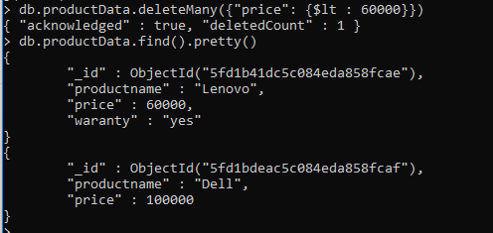
Delete Many with condition

